Slide 1
IT Infrastructure Architecture
Infrastructure Building Blocks
and Concepts
Datacenters
(chapter 7)

Slide 2
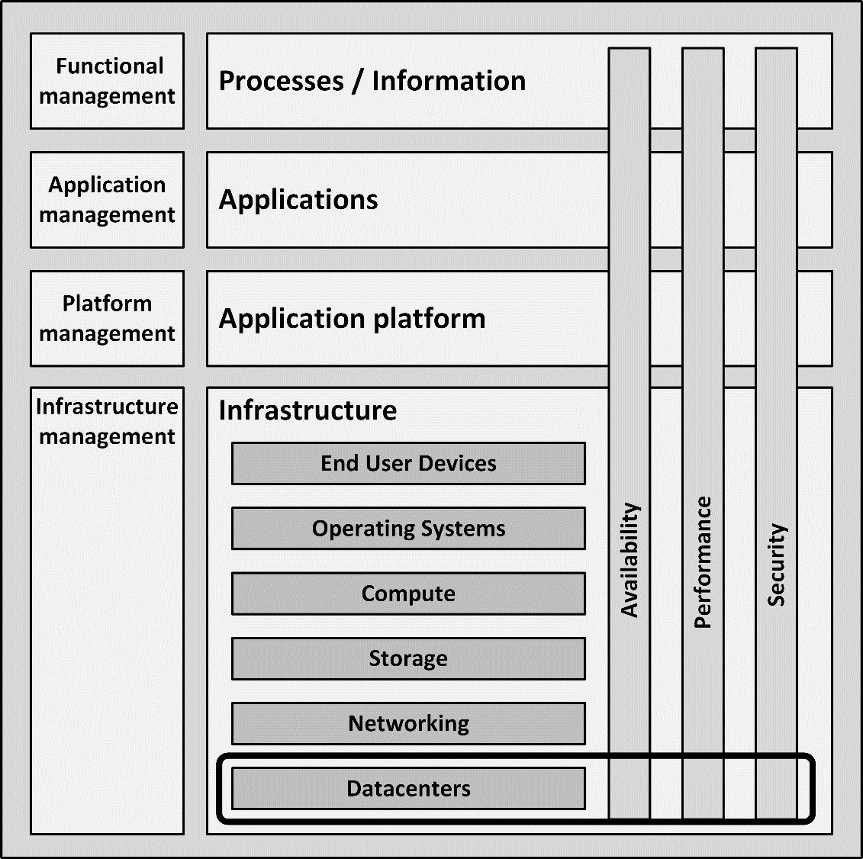
Introduction
Most IT infrastructure hardware, except for end user devices, are hosted in datacenters
A datacenter provides:
Power supply
Cooling
Fire prevention and detection
Equipment racks

Slide 3
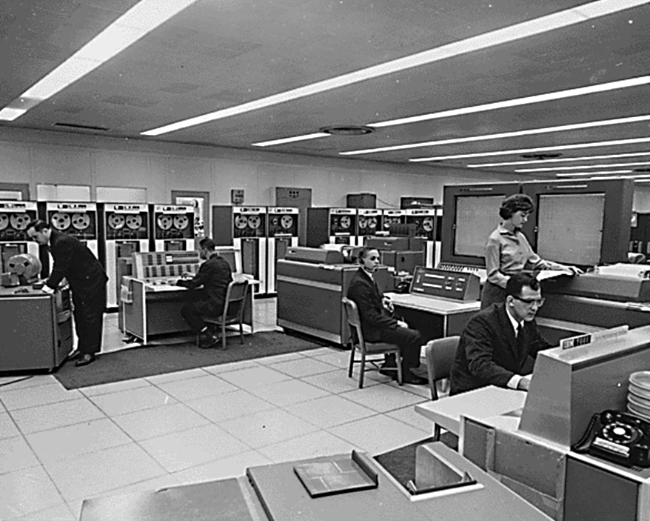
History
Early datacenters (computer rooms) were designed and built for large mainframe systems
A mainframe, together with its peripheral systems easily filled up a large computer room

Slide 4
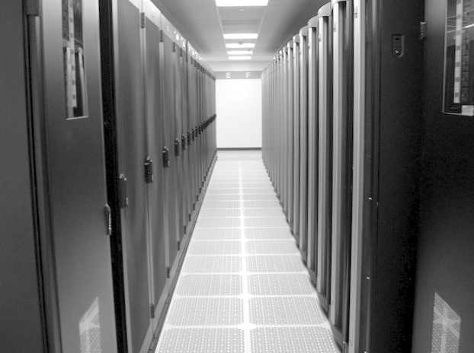
Today’s datacenters
Today’s datacenters are equipped with standardized 19" racks
They house servers, storage devices, and network equipment
They are installed in rows forming corridors between them
Very large datacenters today contain shipping containers packed with thousands of servers each
When repairs or upgrades are needed, entire containers are replaced

Slide 5
Datacenter building blocks

Slide 6
Datacenter categories
Typical datacenter categories:
Sub Equipment Room (SER) – a SER is also known as a patch closet
Main Equipment Room (MER) – a MER is a small datacenter in the organization’s subsidiaries or buildings
Organization owned datacenter – a datacenter that contains all central IT equipment for the organization
Multi-tenant datacenter – used by service providers that provide services for multiple other organizations. These datacenters are typically the largest

Slide 7
Datacenter location
Many variables should be considered to determine where a datacenter could be installed
Examples:
Environment of the datacenter
Visibility of the datacenter
Utilities available to the datacenter
Datacenters located in foreign countries

Slide 8
Physical structure
The physical structure of a datacenter includes components that need special attention:
Floors
Walls
Windows
Doors
Water and gas pipes

Slide 9
Floors
In a typical datacenter, the floor must be able to carry 1500 to 2000 kg/m²
One fully filled 19” computer rack weighs up to 700 kg
The footprint of a rack is about 60x100 cm, leading to a floor load of 1166 kg/m²
In office buildings typically the floor can carry approximately 500 kg/m²

Slide 10
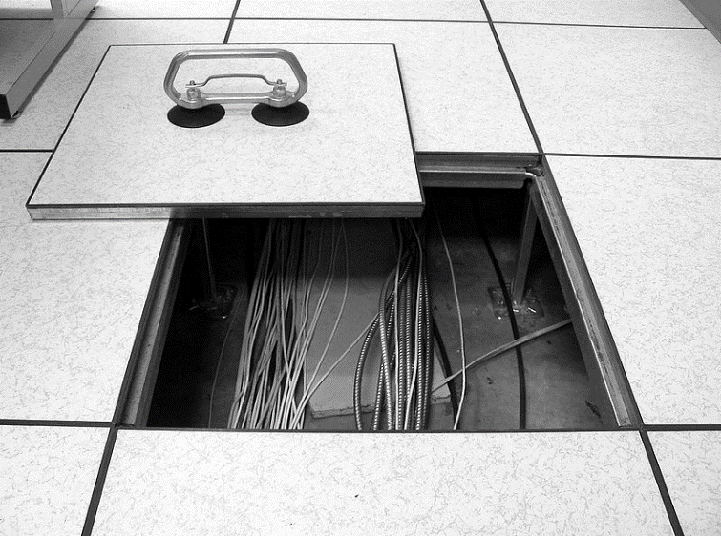
Floors
Raised floors consist of a metal framework carrying removable floor tiles
Tiles are usually 60×60 cm
Tiles can be lifted individually to reach cables installed under the raised floor
Vents provide cool air flow to the racks placed on the floor
Under the raised floor, data and power cables are installed
As alternative, overhead cable trays can be used

Slide 11
Floors
Raised floors have the following disadvantages:
They are expensive
The total available height in the datacenter is decreased
The maximum floor load is limited
Doors and equipment loading slopes are hard to install due to the difference in floor height
Under the raised floor, a fire could easily spread through the entire datacenter

Slide 12
Walls, windows, and doors
Walls should reach from the floor to the building’s ceiling
Because of fire safety and physical intrusion prevention
Adequate fire rating is needed to serve as a physical firewall
Windows are not desirable in a datacenter
Windows must be:
Translucent
Shatterproof
Impossible to open
Doors should be large enough to have equipment brought in
Doors must resist forced entry

Slide 13
Water and gas pipes
Water or gas pipes may have been installed:
Under the floor
In the walls
Above the ceiling of the datacenter
Leakage from water pipes in the ceiling of a datacenter could lead to damage of equipment
Datacenter operators should know where the shutoff valves are

Slide 14
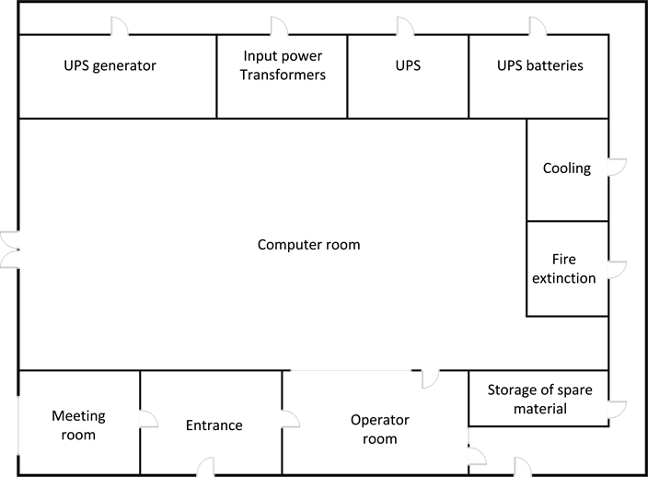
Datacenter layout

Slide 15
Power supply
Energy usage is a key issue for datacenters
Power drawn by datacenters:
A few kilowatts (kW) for one rack of servers
Dozens of megawatts (MW) for large facilities
The amount of power available in a datacenter is expressed as the number of kilowatts per m²
Known as power density
Normal-density datacentre: between 2 to 6 kW/m²
High-density datacentre: between 10 and 20 kW/m²

Slide 16
Power supply
Example:
If a HP DL380 server uses 250W power
A rack could physically hold 40 servers
Available energy density is 2 to 6 kW/m²
Only between 8 and 24 servers can be placed in the rack
In practice most server racks cannot be fully equipped
A high-density datacentre allows racks to be filled with approximately 40 to 80 servers

Slide 17
Uninterruptable Power Supply (UPS)
Power issues can occur in the utility power supply
Possibly leading to:
Downtime
Damage to equipment
Types of power issues:
Blackout
Surge
Spike
Brownout
Waveform issues
An Uninterruptable Power Supply (UPS):
Is independent of the utility power supply
Provides high quality electrical power

Slide 18
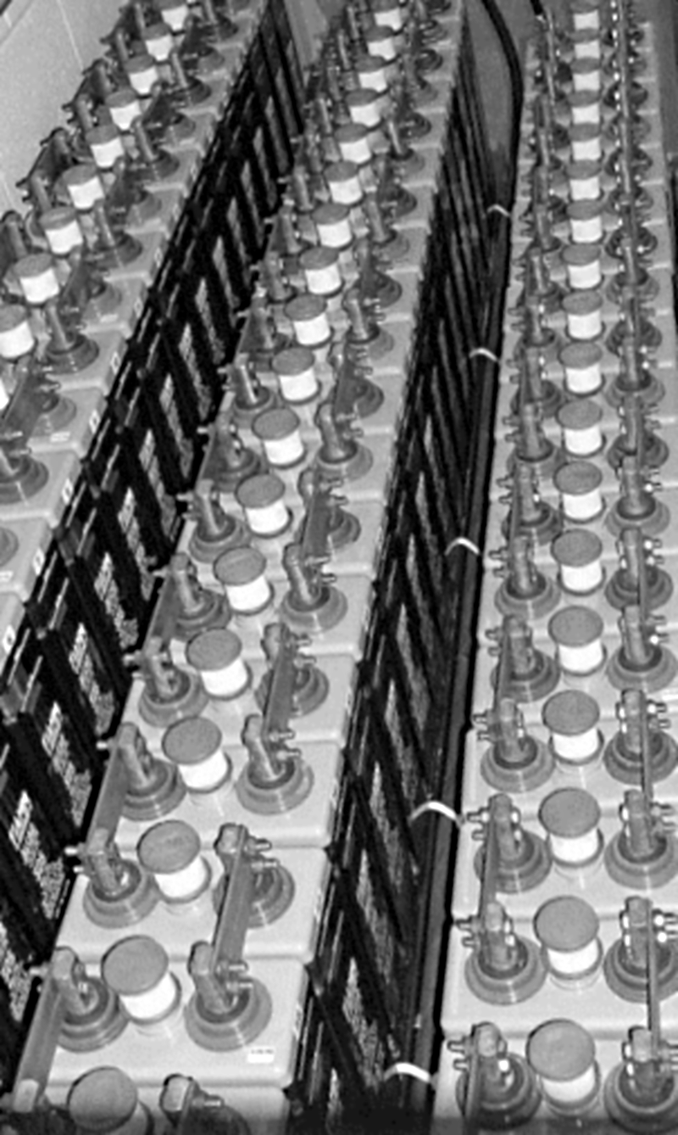
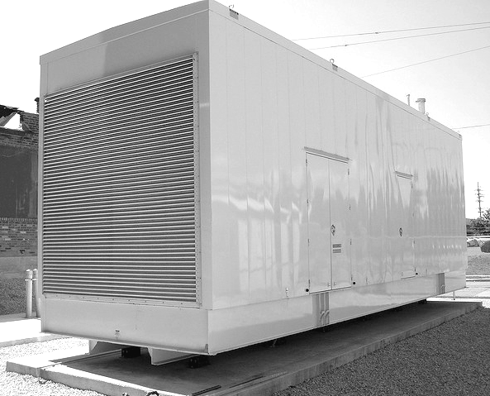
Uninterruptable Power Supply (UPS)
A UPS installation consists of:
Filters
A diesel power generator
A set of batteries or a flywheel system

Slide 19
Uninterruptable Power Supply (UPS)
Battery powered UPSs:
Standby UPS systems (also known as off-line systems)
Used in small setups (a few workstations or servers)
Line interactive UPS systems
Use a transformer between the utility power and the IT equipment
Works as a filter for many of the power issues
Double conversion UPS systems
Convert the AC utility power to DC power and then back to high quality AC power

Slide 20
Power distribution
A power distribution unit (PDU) is a device with multiple power outlets
Distributes power to equipment located in the datacenter
Two types of PDUs:
Large floor mounted PDUs take main feeds (usually 3 phase power) and distribute it into multiple smaller feeds to computer racks
Power Strips that feed equipment in racks
Most Infrastructure components can be equipped with two power supplies for redundancy
For availability reasons at least two power strips are needed to power equipment in a rack
Each feeds one of the two power supplies in the equipment

Slide 21
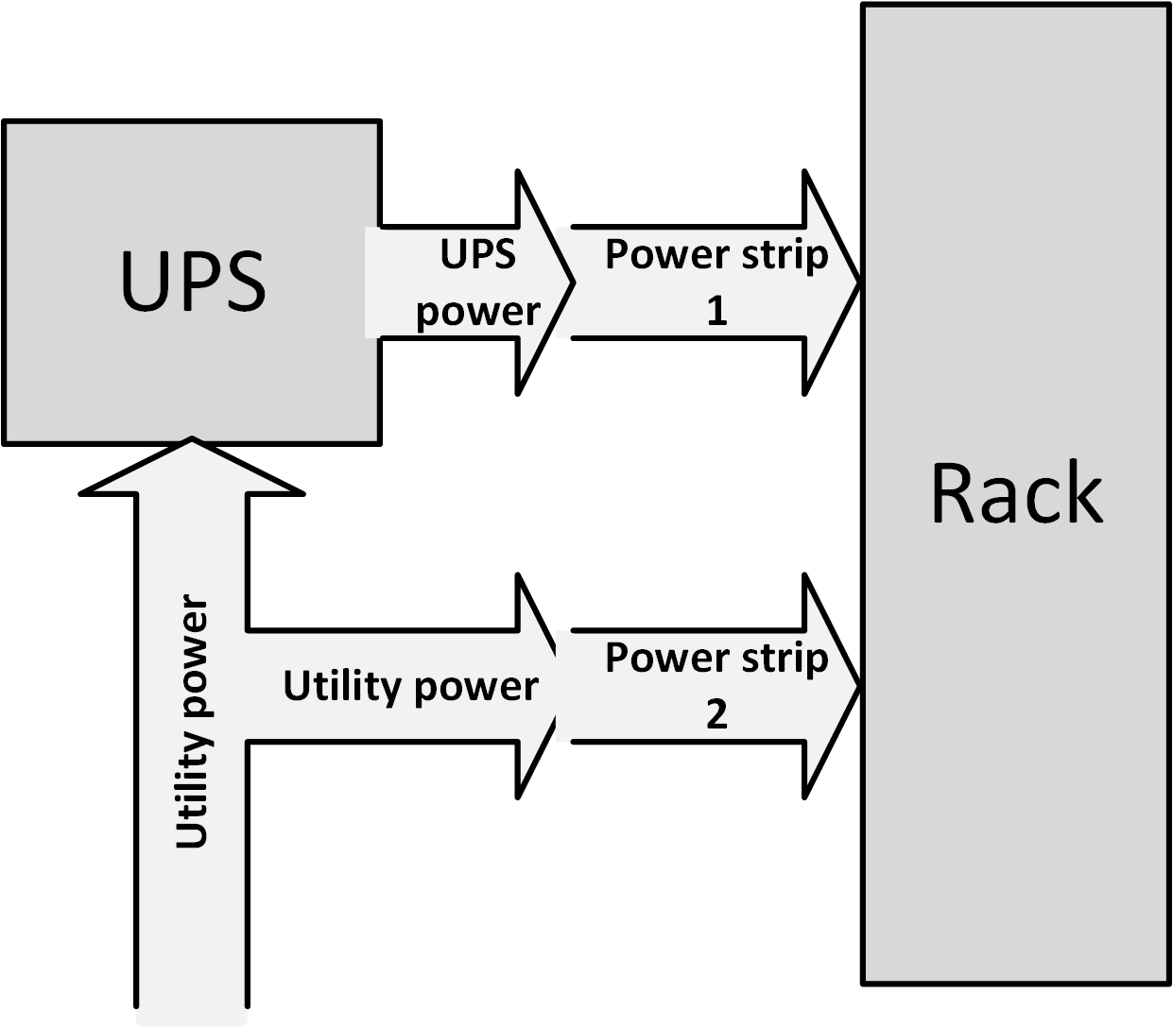
Uninterruptable Power Supply (UPS)
Two independent power feeds to racks
UPS should not be a Single Point of Failure

Slide 22
Cooling
> 90% of all power used by IT infrastructure components is converted into heat
All heat has to be dissipated by a cooling system
Two types of cooling systems:
Computer Room Air Conditioners (CRAC)
Refrigerant-based units connected to outside condensing units
Computer Room Air Handlers (CRAH)
Chilled water based and connected to outside chillers
A chiller produces chilled water via a refrigeration process

Slide 23
Cooling
The efficiency of a cooling system is specified in:
EER - Energy Efficiency Ratio
The measure of efficiency at maximum air conditioning load
The ratio between output cooling in BTU per hour and the electric energy input in Watts at a given operating point
SEER - Seasonal Energy Efficiency Ratio
Same as EER, but seasonal data is used for the measurement
The time of year the cooling system is used most (typically in the summer)
COP - Coefficient Of Performance
The ratio between cooling load in kW and the electric energy input in kW
Normal values are between 3 and 10

Slide 24
Operating temperatures
Infrastructure components have maximum operating temperatures
Servers shut themselves down at an air inlet temperature of 40 degrees Celsius
The air temperature in the datacenter usually ranges from 18 degrees to 27 degrees Celsius
Using higher temperatures saves cooling capacity and power
Raising the temperature in a datacenter with one degree Celsius lowers the cost for cooling by approximately 5%

Slide 25
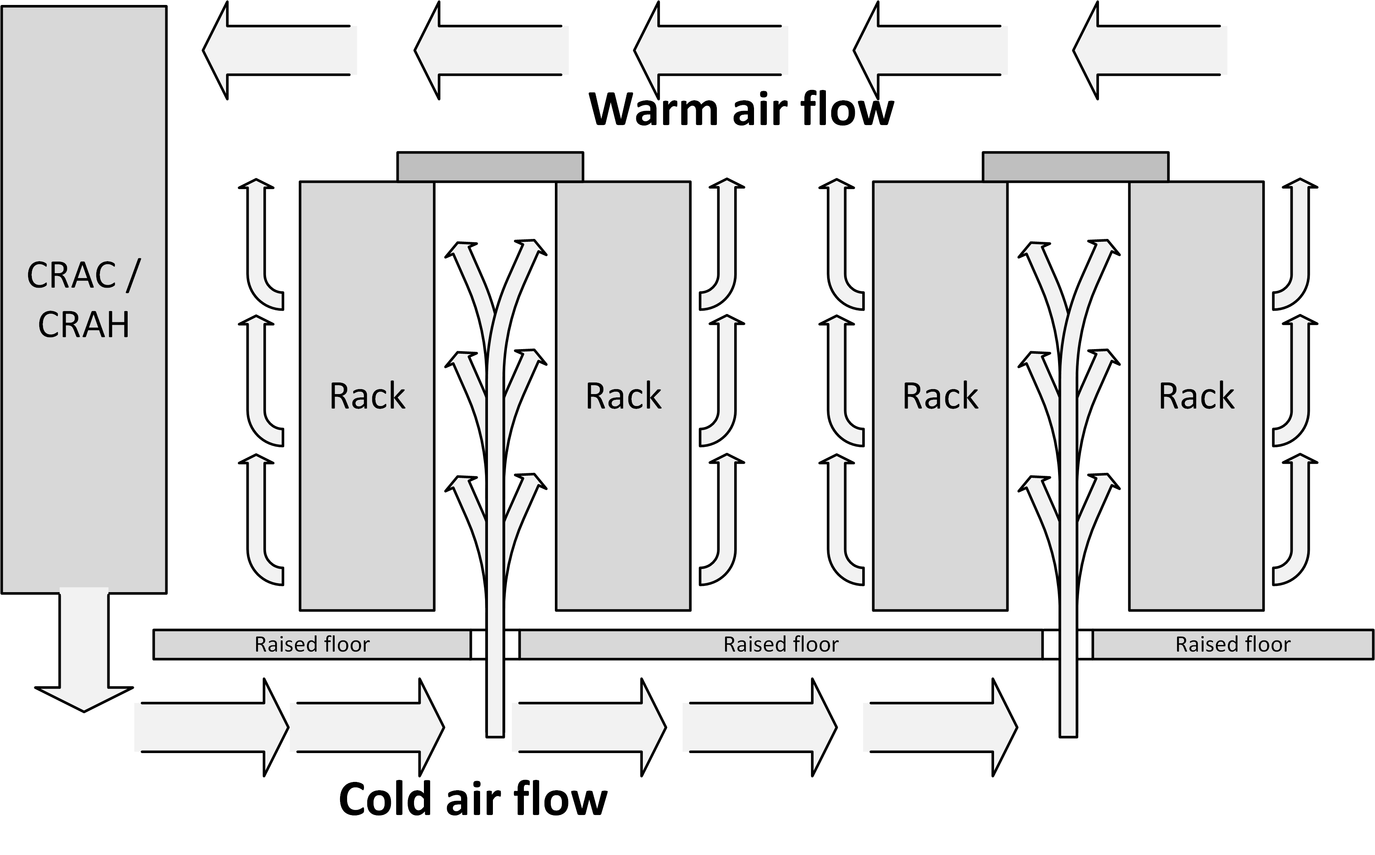
Airflow

Slide 26
Humidity and dust
The humidity of the air in a datacenter is critical for the IT infrastructure components
Air humidity should between 40% and 60%
The number of dust particles in a datacenter should be minimized
Don’t allow visitors in the datacenter
People should wear dust-free clothing (like white coats) and protective sleeves around their shoes

Slide 27
Fire prevention, detection, and suppression
Fire is one of the main enemies of a datacenter
A short circuit in a cable
Defect equipment
Fires can spread around very quickly
Because of the air flow in the datacenter and the frequent use of raised floors
Smoke could damage equipment in the datacenter
Even if a fire starts outside of the datacenter’s computer room

Slide 28
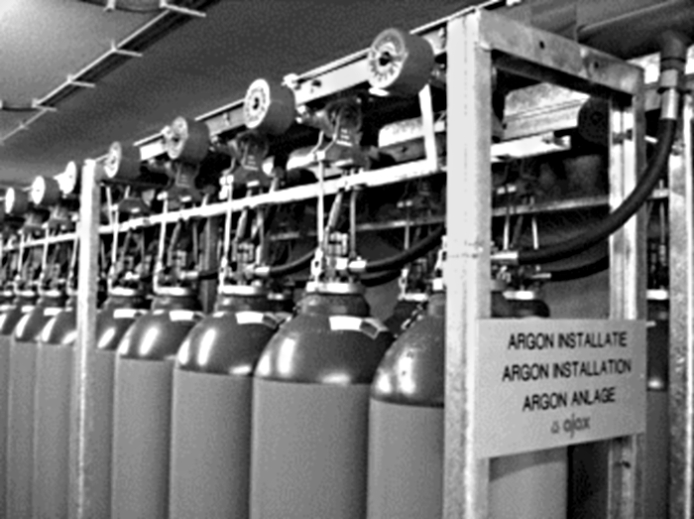
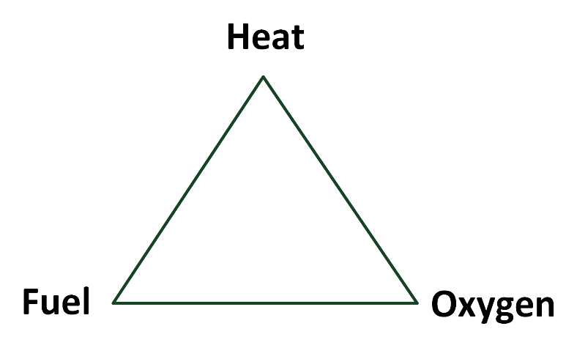
Fire prevention, detection, and suppression
Suppressing fire in a datacenter consists of four levels:
Fire prevention – Avoid a fire
Passive fire protection – Limit the exposure of the fire once it has started
Fire detection systems – Detect smoke and fire
Fire suppression systems – Extinguish the fire once it is detected

Slide 29
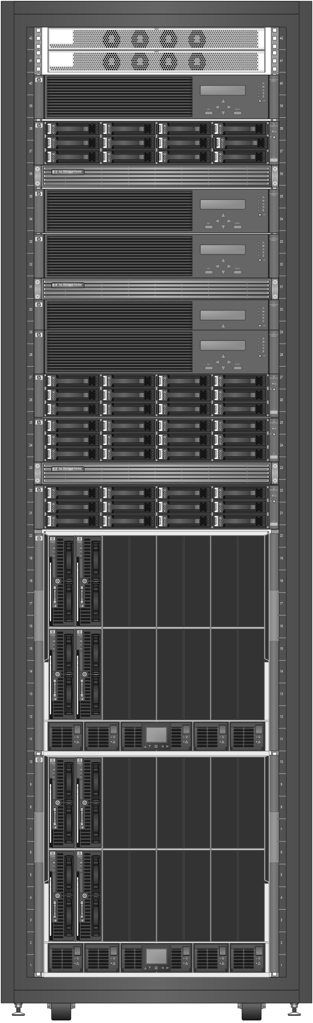
Equipment racks
A 19” rack is a standardized metal enclosure to house IT infrastructure components
The height of a rack is measured in rack unit or 'U‘
One U is 44.5 mm
A typical rack is 42U high

Slide 30
Datacenter energy efficiency
IT accounts for approximately 2% of all the world’s CO₂ emissions
During the lifetime of a server the amount of money spent on electricity can be much higher than the cost of the server itself
The datacenter itself uses power as well
Cooling system
Lighting
Heating of the operator rooms
Etc.

Slide 31
Datacenter energy efficiency
The Power Usage Effectiveness (PUE) metric measures the power used by the datacenter
The PUE is calculated by dividing the amount of power used by the datacenter, by the power used to run the IT equipment in it
Typical PUE value of a datacenter is between 1.1 and 2.0
Running a datacenter with a PUE of 1.5 means that for each watt of power used by the IT equipment an extra half watt is used by the rest of the datacenter

Slide 32
Datacenter availability

Slide 33
Availability tiers

Slide 34
Availability tiers

Slide 35
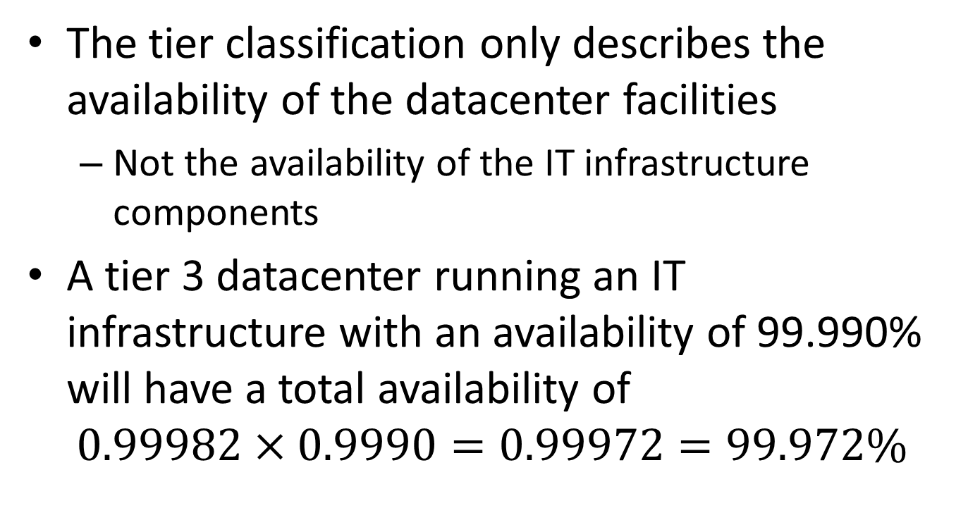
Availability tiers
The tier classification only describes the availability of the datacenter facilities
Not the availability of the IT infrastructure components
A tier 3 datacenter running an IT infrastructure with an availability of 99.990% will have a total availability of
$$0.99982×0.9990=0.99972=99.972\%$$

Slide 36
Redundant datacenters
Multiple redundant datacenters can be used to increase availability
Multiple datacenters are a must when higher availability than 99.995% is needed
If a datacenter with all its equipment has an availability lower than tier 1, two datacenters can reach an availability of the same level as one tier 4 datacenter
Redundant datacenters should be at least 5 km apart
Based on the effect of incidents like the 9/11 terrorist attacks in the USA and reports of explosions in factory plants and fireworks storage

Slide 37
Datacenter performance

Slide 38
Datacenter performance
The datacenter itself does not provide performance to IT Infrastructures, except for the bandwidth of the internet connectivity and the scalability of the location

Slide 39
Datacenter security

Slide 40
Physical security
Ensure that equipment is physically safe behind the datacenter doors
Physical access to the datacenter must be restricted to selected and qualified staff
An entry registration system should be used
A log should be maintained containing all staff entering and leaving the datacenter
Doors must be secured using conventional locks (for instance for dock loading doors) or electronic locks
Electronic locks should open only after proper authentication

Slide 41
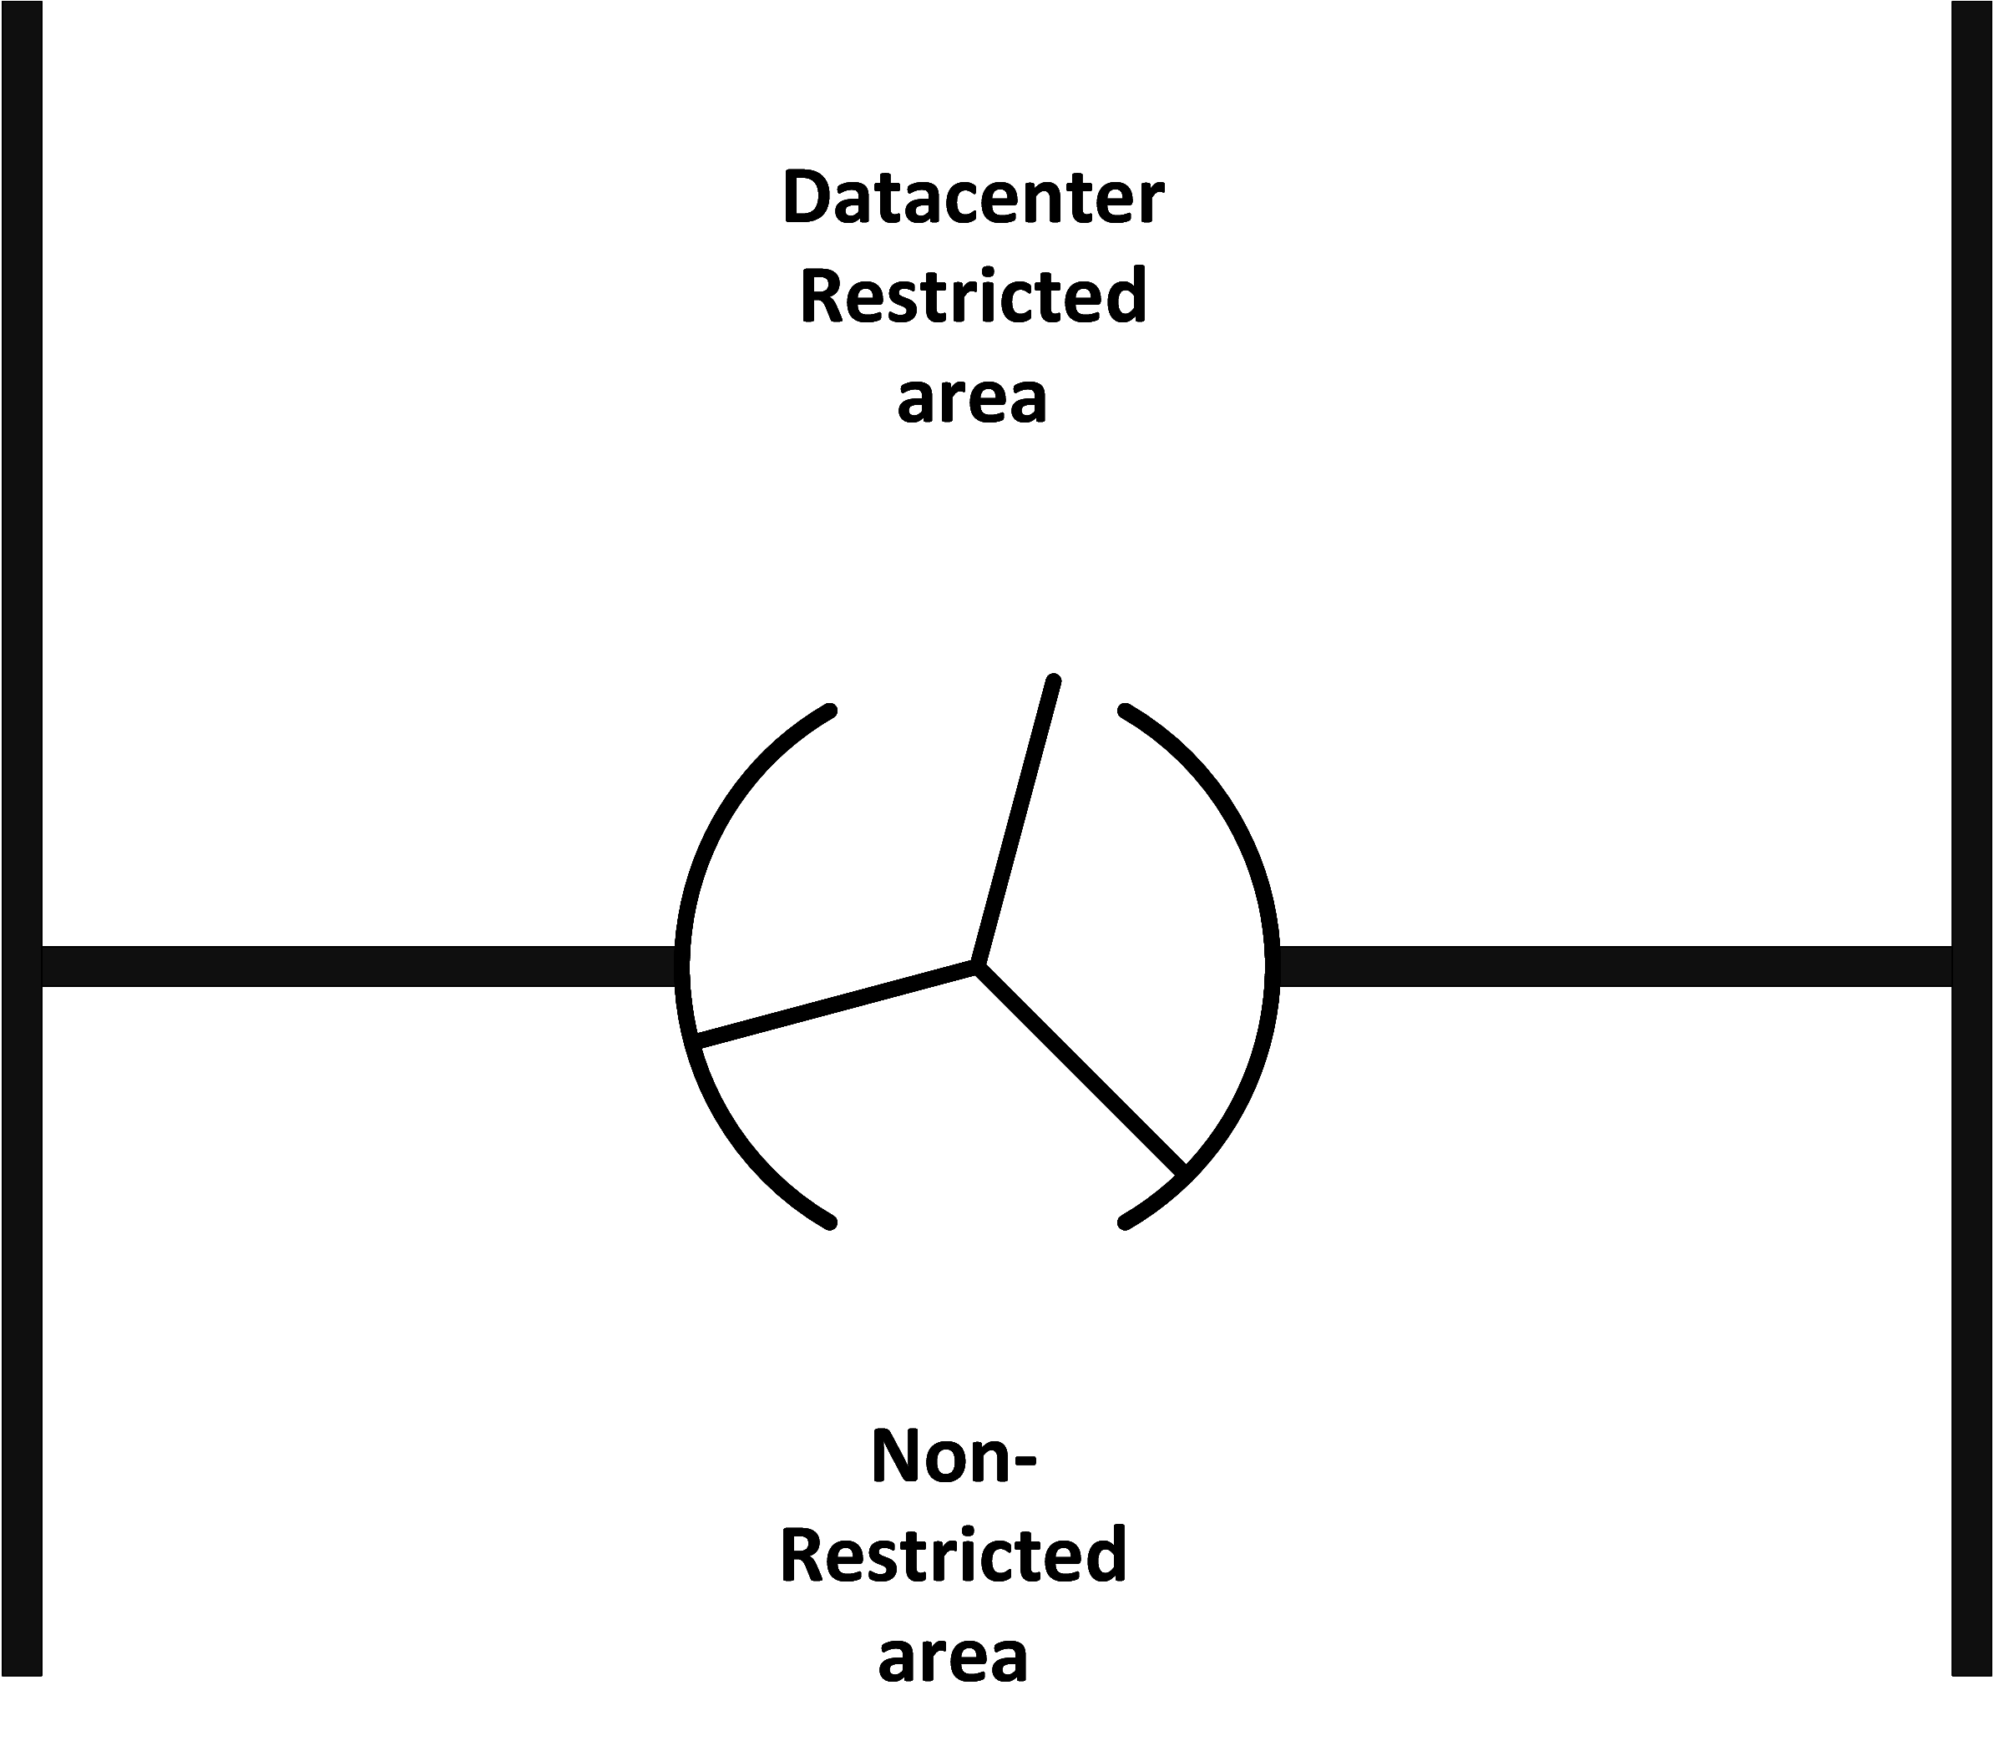
Physical security
Entry points can be implemented as:
Regular doors
Mantraps
Staff is routed through a set of double doors that may be monitored by a guard
Revolving doors
Only one person at a time can enter the datacenter’s restricted area
Entries can be equipped with weighing scales to ensure only one person enters the restricted area

